Slide 1
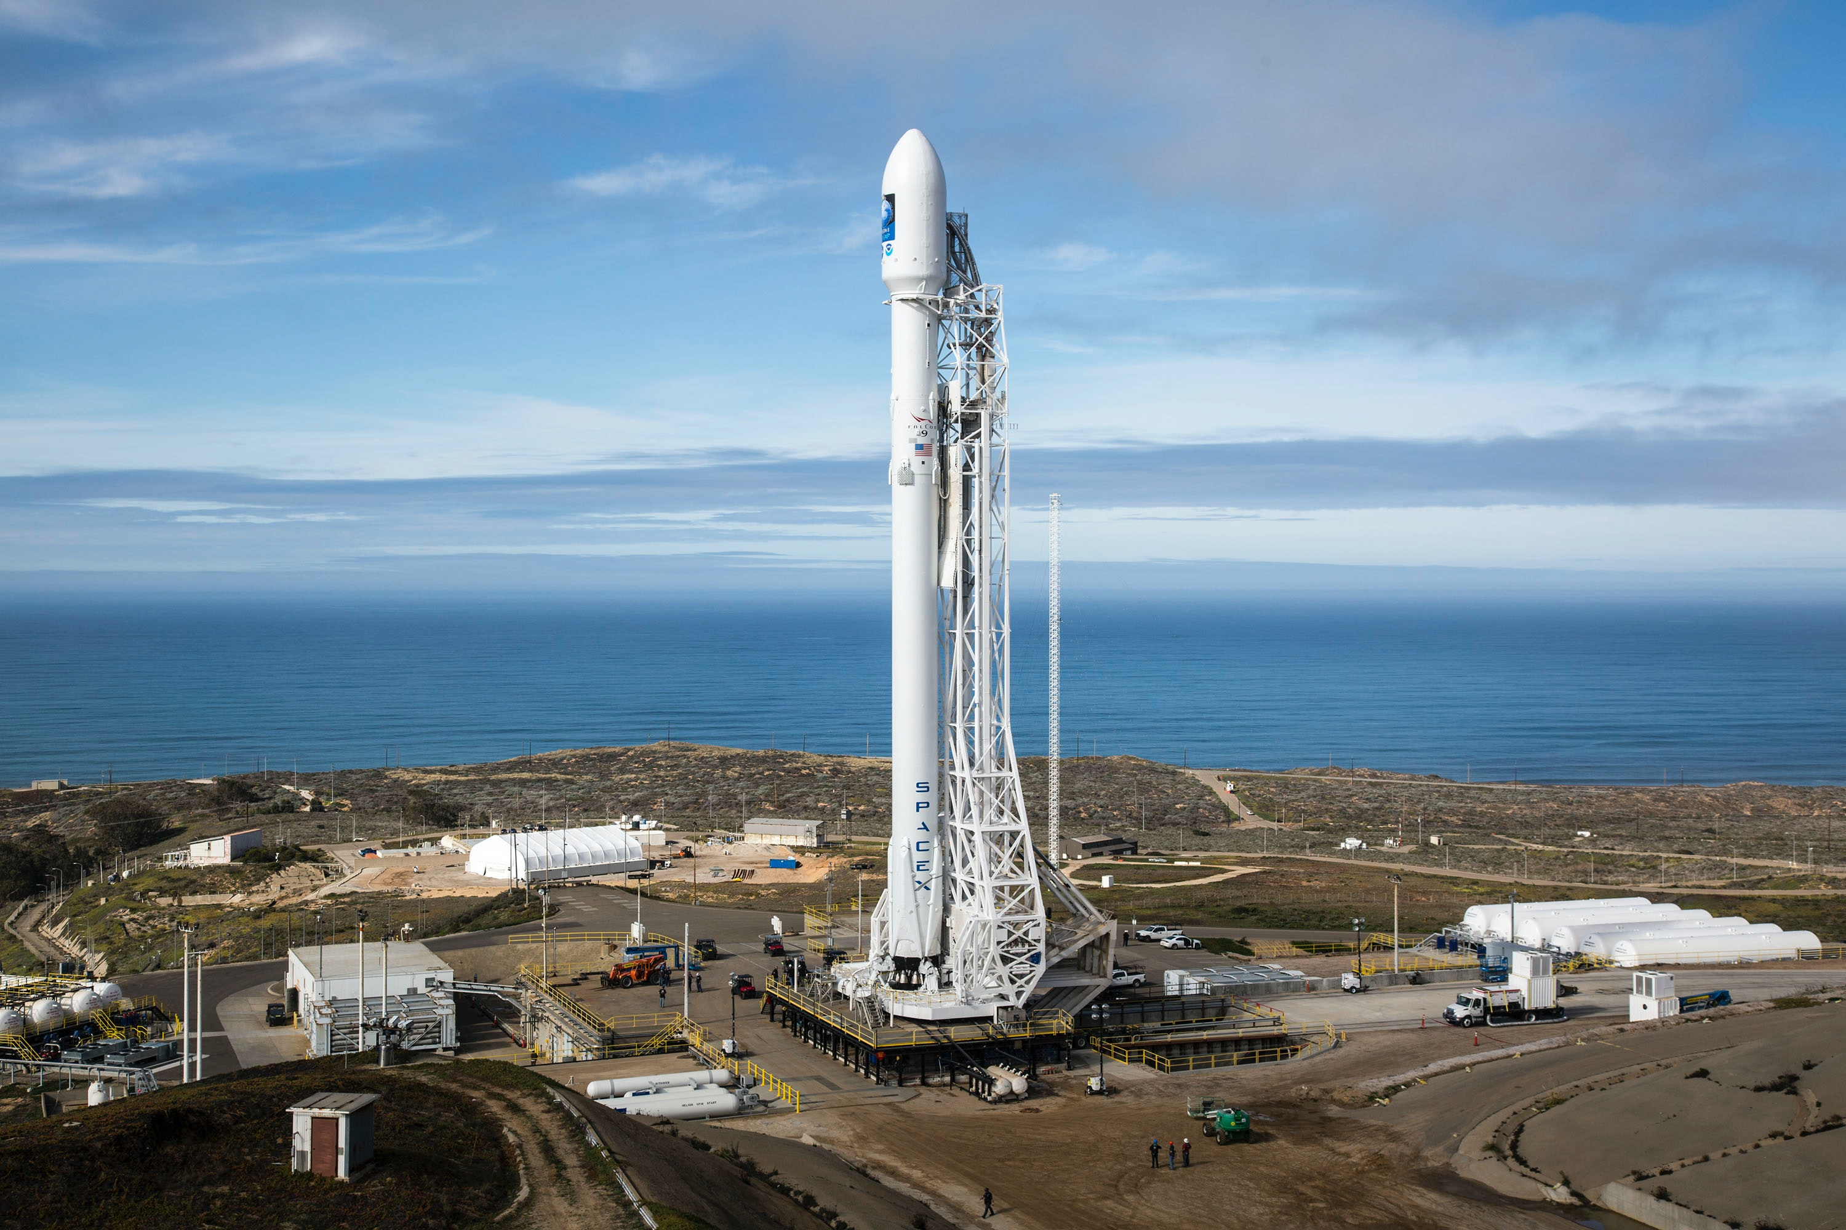






Saving Private Rockets with Data Science Predicting SpaceX Falcon 9 Landing Success Using Machine Learning
Matteo Meloni
2022/12/18

Slide 2
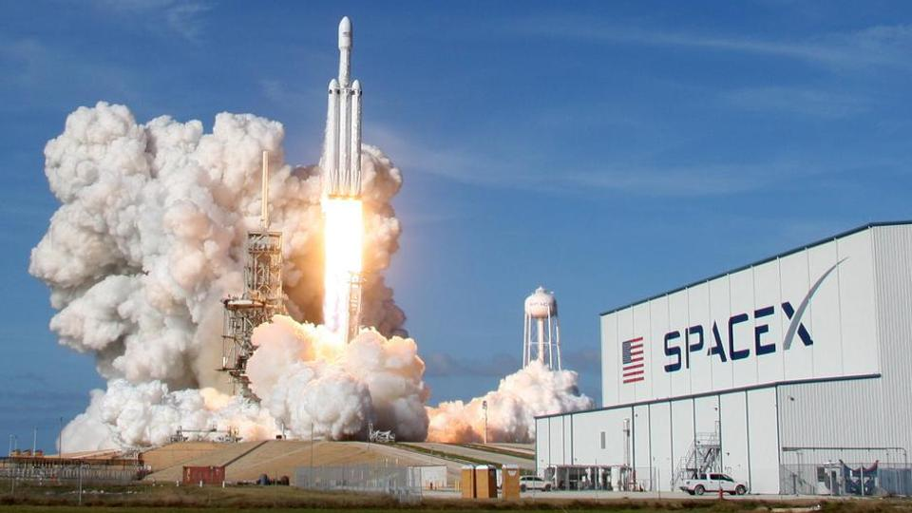


OUTLINE
Executive Summary
Introduction
Methodology
Results
Visualisation – Charts
Dashboard
Discussion
Findings & Implications
Conclusion
Appendix

Slide 3

EXECUTIVE SUMMARY
The following methodologies were used for data analysis:
Data collection using web scraping and the SpaceX API
Exploratory data analysis (EDA), including data wrangling, data visualisation and interactive visual analytics.
Machine-learning prediction.
Summary of results:
Valuable data were collected from public sources.
EDA helped identify the best features for predicting launch success.
Machine-learning prediction identified the characteristics that were most important for designing the best model using the collected data.

Slide 4

INTRODUCTION
OBJECTIVE:
Evaluate whether the new company, Space Y, could compete successfully with SpaceX.
Key questions:
How to estimate total launch cost by predicting successful first-stage landings;
Where the best launch site is.

Slide 5

METHODOLOGY

Slide 6
METHODOLOGY
Data collection
SpaceX data were obtained from two sources:
SpaceX API (https://api.spacexdata.com/v4/rockets/).
Web scraping (https://en.wikipedia.org/wiki/List_of_Falcon_9_and_Falcon_Heavy_launches)
Data wrangling
Exploratory data analysis (EDA) using SQL and visualisation.

Slide 7
METHODOLOGY
Analysis approach
• Interactive visual analytics using Folium and Plotly Dash
• Predictive analysis using classification models
The data collected up to this point were normalised, divided into training and test datasets, and evaluated using four different classification models. The accuracy of each model was evaluated using different parameters.

Slide 8
DATA COLLECTION
• SpaceX API (https://api.spacexdata.com/v4/rockets/)
• Wikipedia
( https://en.wikipedia.org/wiki/List_of_Falcon/_9/_and_Falcon_Heavy_launches ),
using web scraping techniques.

Slide 9
SPACEX API
Request the API and parse the SpaceX launch data
• SpaceX offers a public API
• This API was used according to the
flowchart shown here
• Source code:
https://github.com/MatteoMel1985/Applied-Data-Science-Capstone/blob/main/Hands-on%20Lab%20Complete%20the%20Data%20Collection%20API%20Lab.ipynb
Filter data to include only
Falcon 9
launches
Deal with missing values

Slide 10
WEB SCRAPING
SpaceX launch data_x000B_can also be obtained from_x000B_Wikipedia;
Data were downloaded from_x000B_Wikipedia and processed as follows
Source code:
https://github.com/MatteoMel1985/Applied-Data-Science-Capstone/blob/main/jupyter-labs-webscraping.ipynb
Request the Falcon 9
launch Wiki page
Extract all column and variable
names from the HTML
table header
Create a data frame by
parsing the launch HTML
tables

Slide 11
DATA WRANGLING
• Initially, exploratory data analysis (EDA) was performed on the dataset.
• Then, launches per site, occurrences of each orbit, and mission outcomes per orbit type were calculated.
• Finally, the Landing Outcome label was created from the Outcome column.
Source code:
https://github.com/MatteoMel1985/Applied-Data-Science-Capstone/blob/main/Data%20Wrangling%20Overview.ipynb
EDA
Summarisation
Creation of Landing Outcome label

Slide 12
EDA WITH SQL
• SQL queries were performed in order to study the data (see source code). Among them:
• Total number of successful and failed mission outcomes;
• Failed landing outcomes on drone ships, their booster versions, and launch site names in 2015;
• Ranking of landing outcome counts, such as Failure (drone ship) or Success (ground pad), between 2010-06-04 and 2017-03-20.
Source code:
https://github.com/MatteoMel1985/Applied-Data-Science-Capstone/blob/main/Complete%20the%20EDA%20with%20SQL.ipynb

Slide 13
EDA WITH DATA VISUALISATION
• To explore the data, scatterplots and bar plots were used to visualise the relationships between pairs of features:
• The analysed feature pairs were: Payload Mass vs. Flight Number, Launch Site vs. Flight Number, Launch Site vs. Payload Mass, Orbit vs. Flight Number, and Payload vs. Orbit.
Source code:
https://github.com/MatteoMel1985/Applied-Data-Science-Capstone/blob/main/IBM-DS0321EN-SkillsNetwork_labs_module_2_jupyter-labs-eda-dataviz.ipynb.jupyterlite(1).ipynb

Slide 14
INTERACTIVE MAPS WITH FOLIUM
• Markers, circles, lines and marker clusters were used with Folium maps:
• Markers indicate points such as launch sites;
• Circles indicate highlighted areas around specific coordinates, such as NASA Johnson Space Center;
• Marker clusters indicate groups of events at each coordinate, such as launches at a launch site;
• Lines are used to indicate distances between two coordinates.
Source code:
https://github.com/MatteoMel1985/Applied-Data-Science-Capstone/blob/main/IBM-DS0321EN-SkillsNetwork_labs_module_3_lab_jupyter_launch_site_location.jupyterlite.ipynb

Slide 15
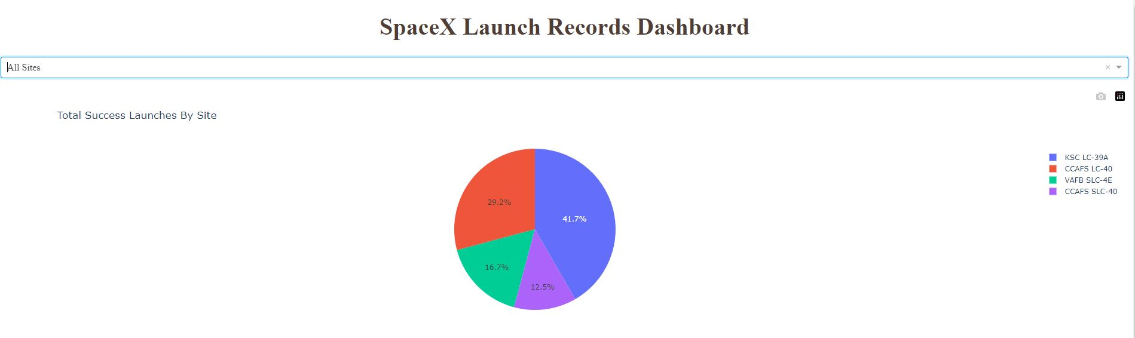
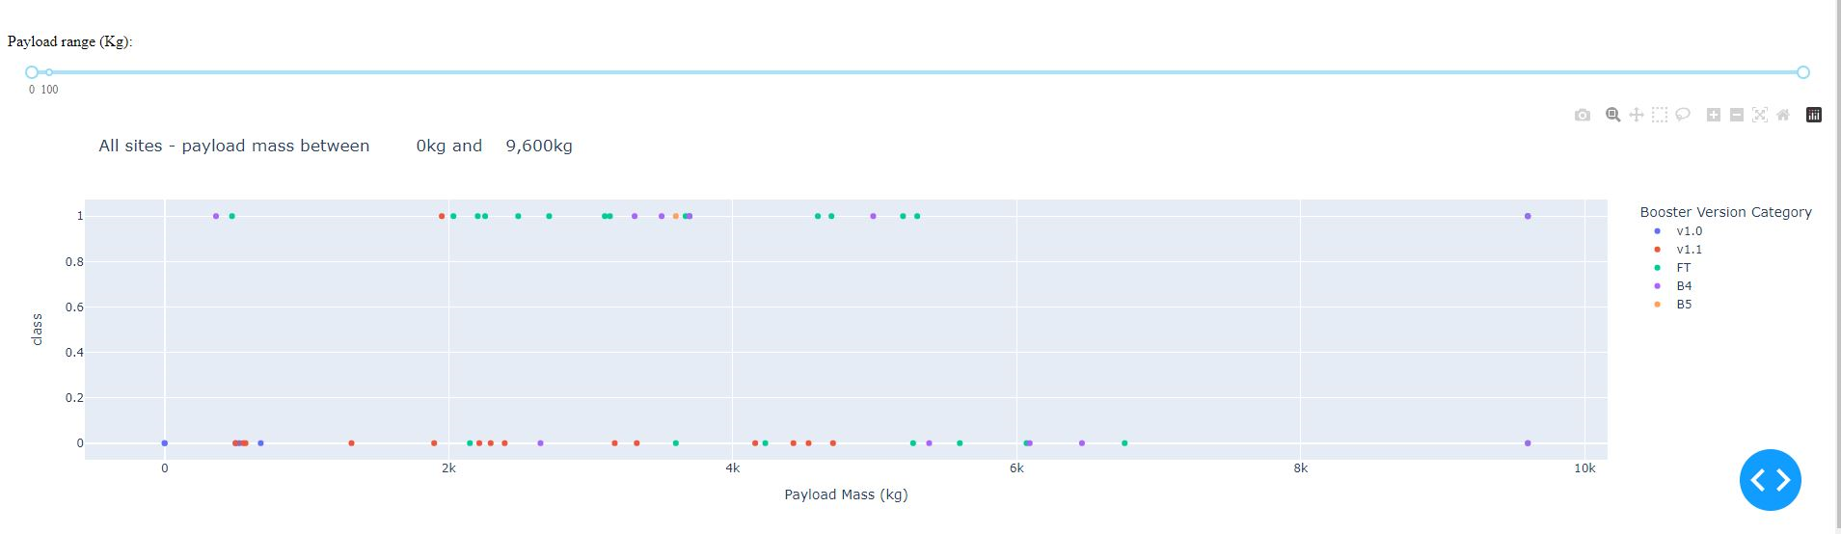
DASHBOARD WITH PLOTLY DASH
• The following graphs and plots were used to visualise data:
• Percentage of launches by site
• Payload range
• This combination enables quick analysis of the relationships between payloads
and launch sites, helping to identify the best launch site according
to payload range.

Slide 16
PREDICTIVE ANALYSIS
• Four classification models were compared: logistic regression, support vector
machine, decision tree, and k-nearest neighbours.
Data
preparation
and
standardisation
Testing each model
with combinations
of
hyperparameters
Comparison of
results
Source code:​
https://github.com/MatteoMel1985/Applied-Data-Science-Capstone/blob/main/IBM-DS0321EN-SkillsNetwork_labs_module_4_SpaceX_Machine_Learning_Prediction_Part_5.jupyterlite.ipynb

Slide 17
RESULTS
Exploratory data analysis results:
• SpaceX uses four different launch sites;
• The first launches were performed by SpaceX itself and NASA;
• The average payload of F9 v1.1 booster is 2,928 kg;
• The first successful landing happened in 2015, five years after the first launch;
• Many Falcon 9 boosters landed successfully on drone ships with above-average payloads;
• Almost 100% of mission outcomes were successful;
• Two booster versions failed at landing in drone ships in 2015: F9 v1.1 B1012 and F9 v1.1 B1015;
• Landing outcomes improved over time.

Slide 18
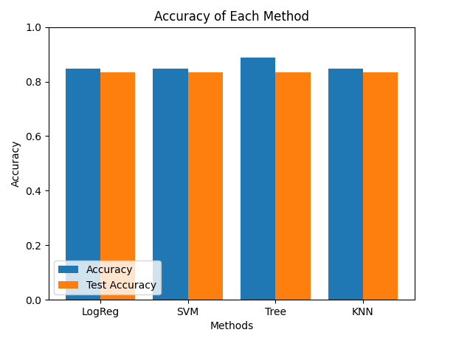
RESULTS
• Interactive analytics showed that launch sites are located in safe places, near the sea, and served by good logistical infrastructure.
• Most launches happened at the East Coast launch sites.
• Predictive analysis showed that the Decision Tree Classifier was the best model for predicting successful landings, with accuracy above 87% and test accuracy above 94%.

Slide 19

DISCUSSION
EDA INSIGHTS

Slide 20
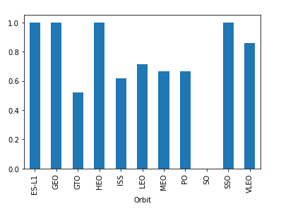
SUCCESS RATE VS ORBIT TYPE
The highest success rates occur in the following orbits:
• ES-L1
• GEO
• HEO
• SSO
Followed by:
• VLEO (above 80%)
• LFO (above 70%)

Slide 21
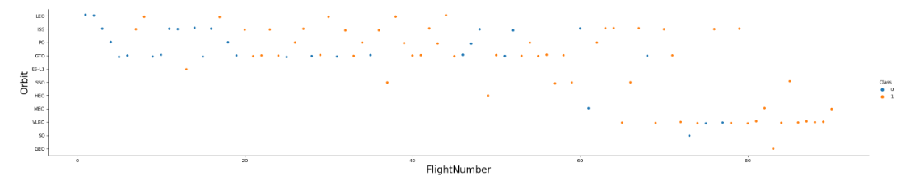
FLIGHT N° VS ORBIT TYPE
• Success rates appear to have improved over time across all orbits.
• The VLEO orbit seems to present a new business opportunity due to the recent increase in its
frequency.

Slide 22
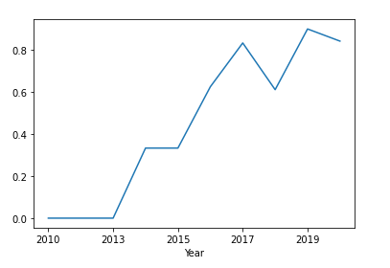
LAUNCH SUCCESS YEARLY TREND
• The success rate started increasing in 2013 and continued improving until 2020.
• The first three years seem to have been a period of adjustments and technological improvement.

Slide 23
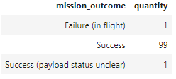

SUCCESSFUL AND FAILURE OUTCOMES
• Number of successful and failed mission outcomes
• First successful landing outcome on a ground pad

Slide 24
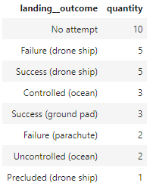
RANKING OF LANDING OUTCOMES
• Ranking of all landing outcomes between 2010/06/04 and 2017/03/20:

Slide 25
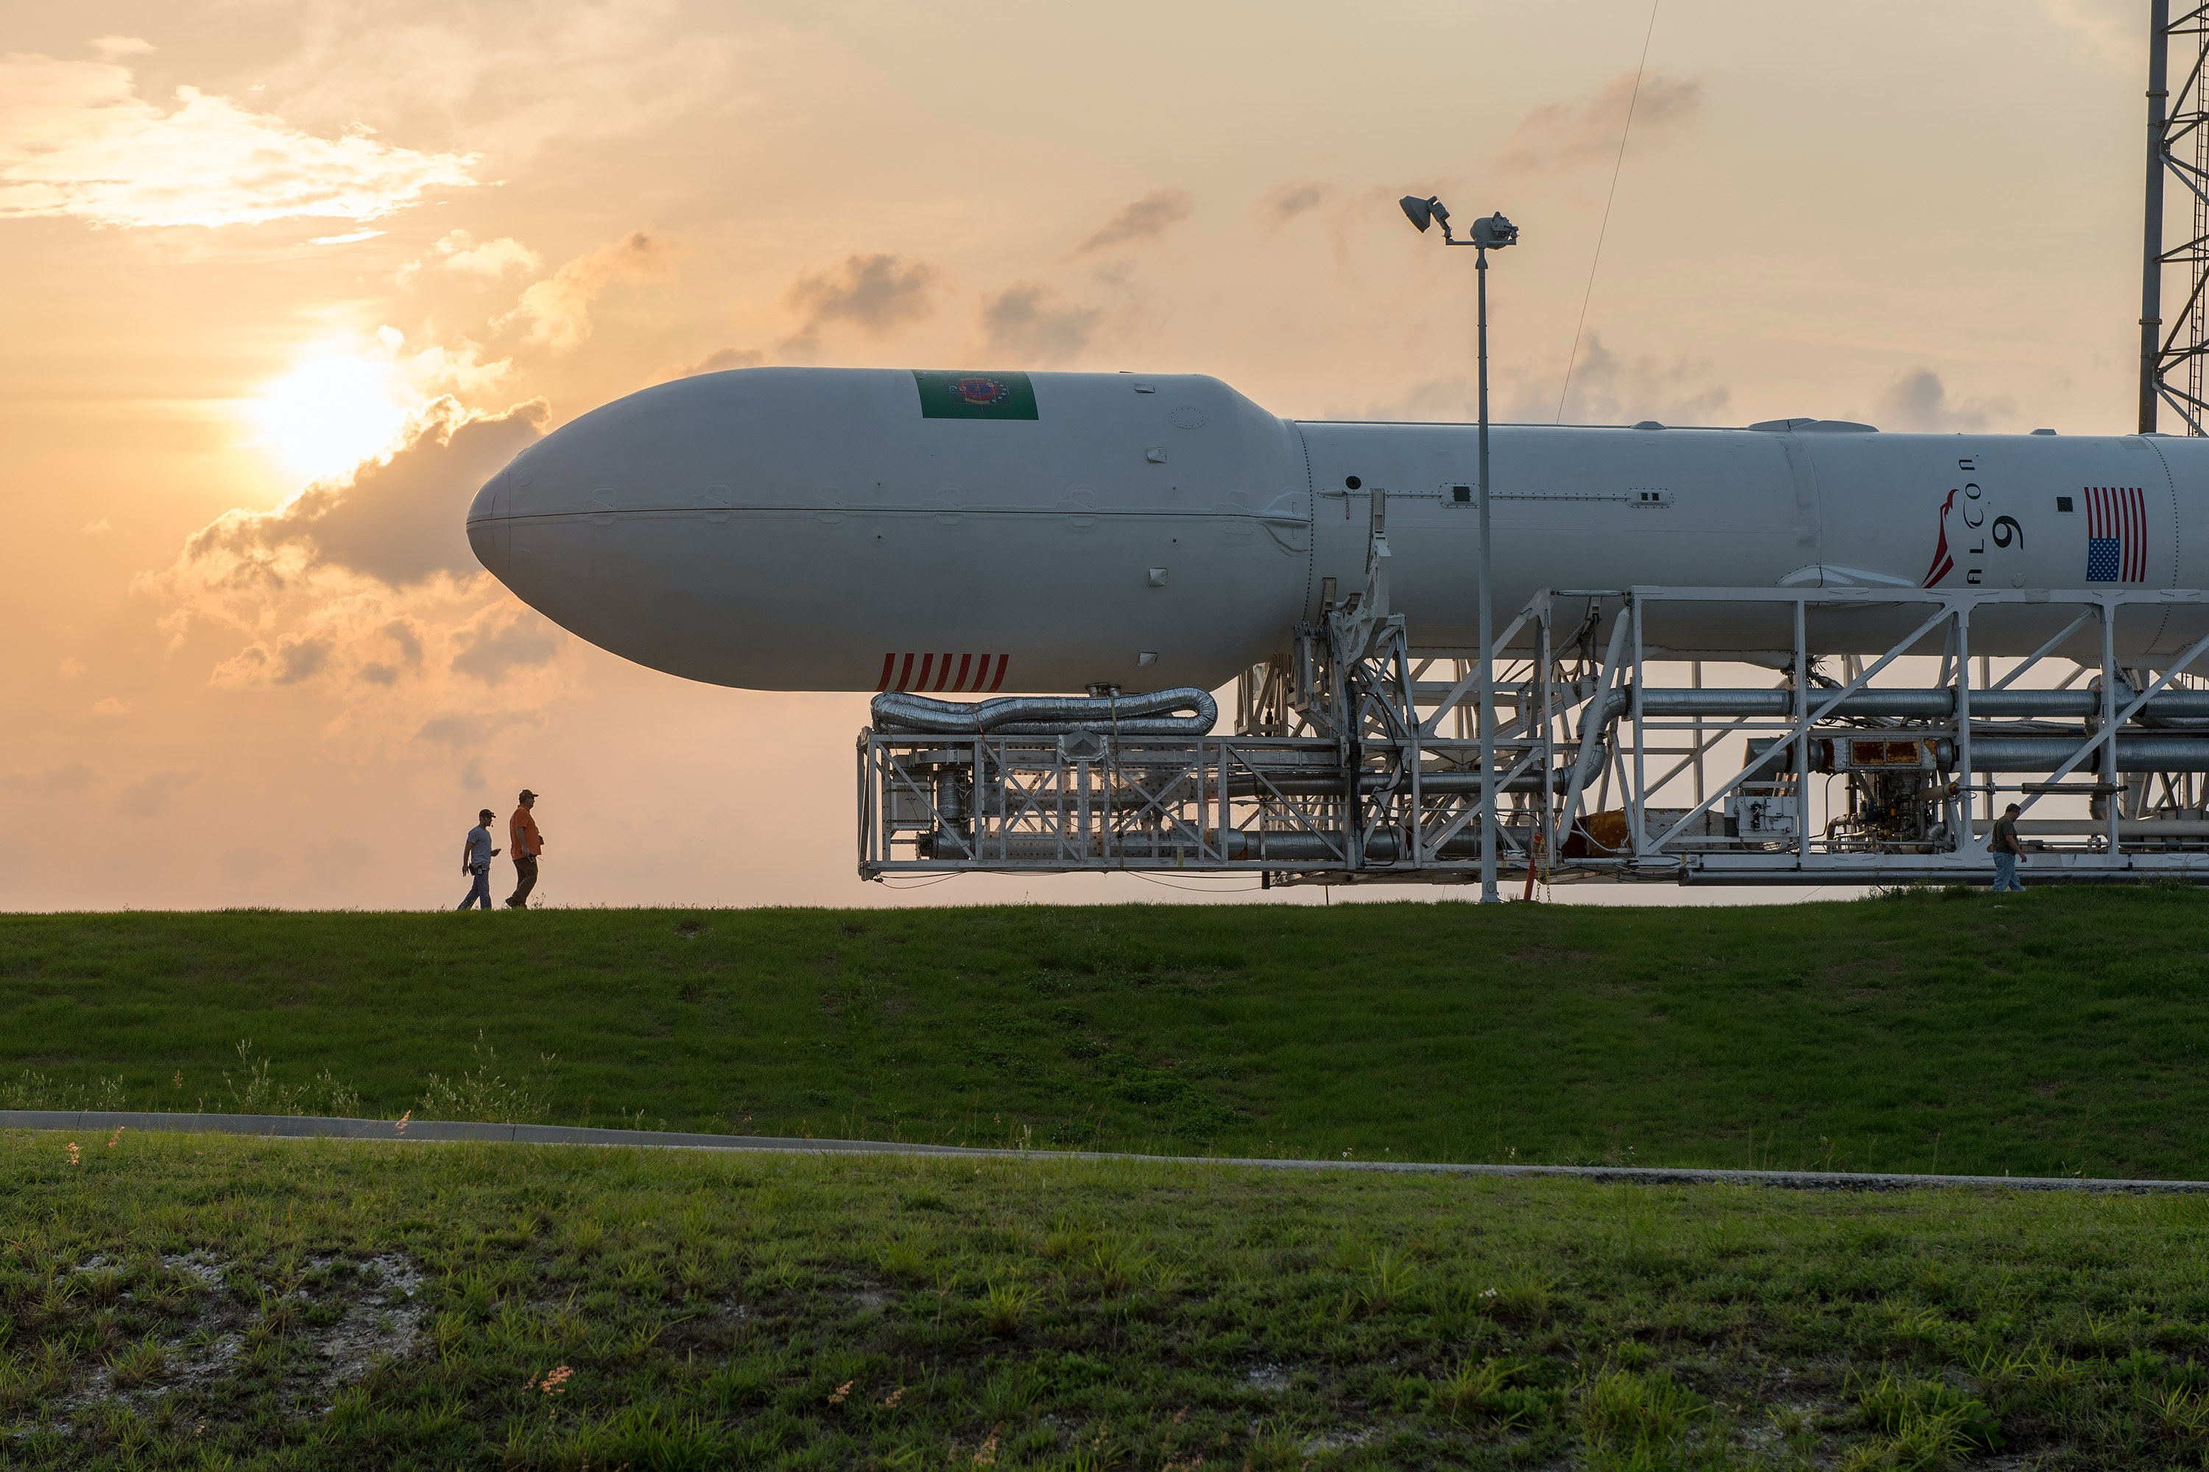
LAUNCH SITES PROXIMITY ANALYSIS

Slide 26
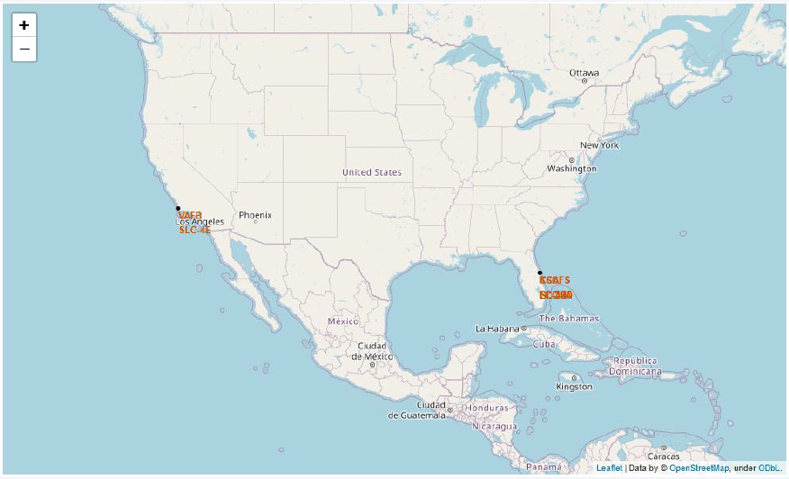
ALL LAUNCH SITES
• Launch sites are near the sea, but not too far from roads and railroads.

Slide 27
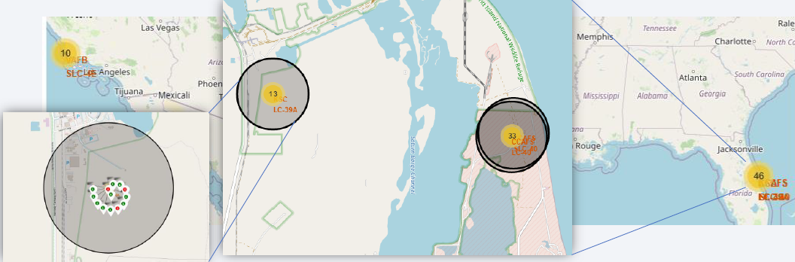
LAUNCH OUTCOME BY SITE
• Example of launch outcomes at KSC LC-39A
• Green markers indicate successes; red markers indicate failures

Slide 28
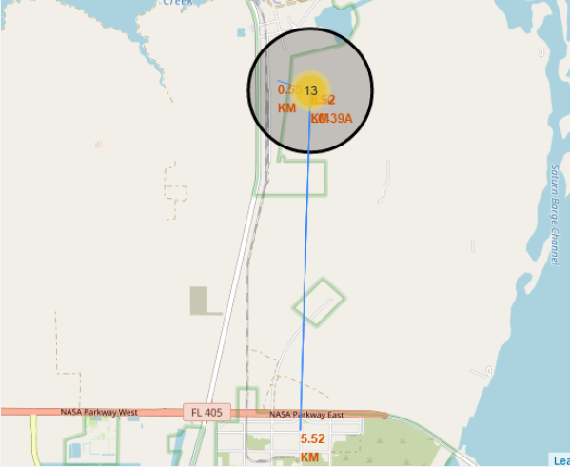
LOGISTIC AND SAFETY
• KSC LC-39A has good logistical advantages, being located near railways and roads; however, it is relatively far from inhabited areas.

Slide 29

PLOTLY DASH DASHBOARD

Slide 30

SUCCESSFUL LAUNCHES BY SITE
• Launch locations seem to be a very important factor for mission success.

Slide 31
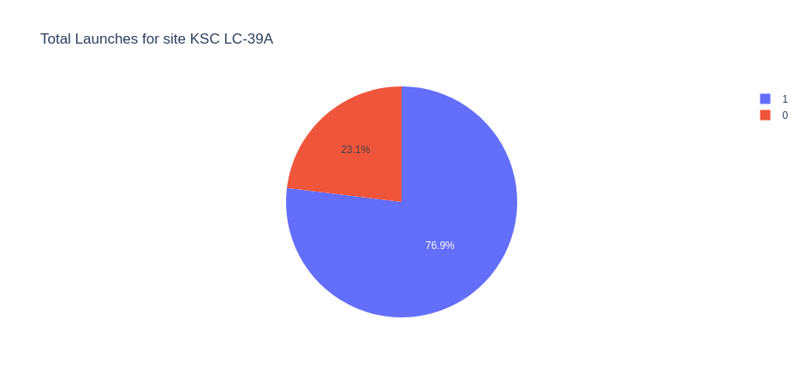
KSC LC-39A LAUNCH SUCCESS RATIO
• 76.9% of launches are successful at this site.

Slide 32
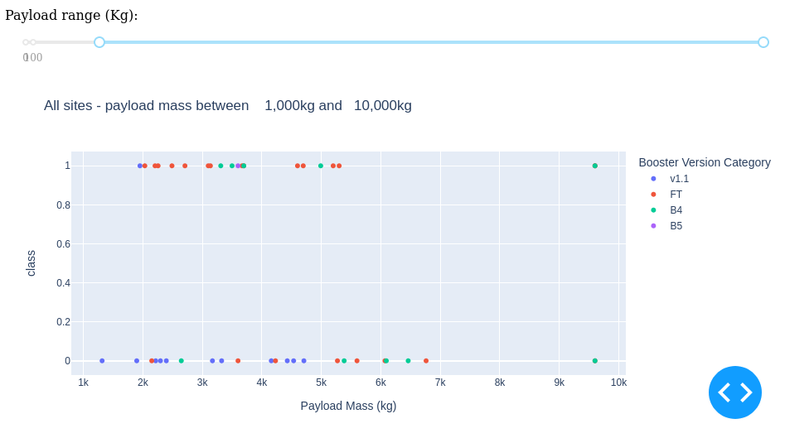
PAYLOAD VS LAUNCH OUTCOME
• Payloads below 6,000 kg with FT boosters are the most successful combination.

Slide 33
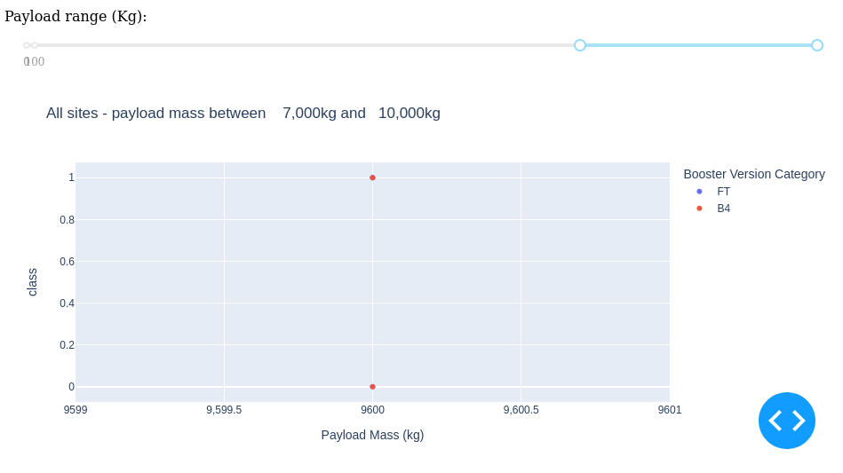
PAYLOAD VS LAUNCH OUTCOME
• Not enough data are available to estimate the risks of launches over 7,000 kg.

Slide 34

PREDICTIVE ANALYSIS

Slide 35
CLASSIFICATION ACCURACY
• Four classification models were tested, and their accuracies were plotted.
• The model with the highest classification accuracy is the Decision Tree Classifier, whose accuracy score is above 87%.

Slide 36
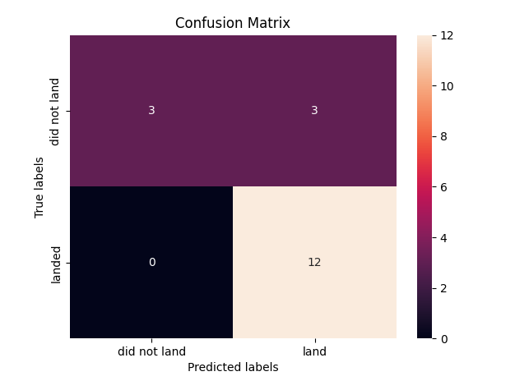
CONFUSION MATRIX OF DECISION TREE
• The confusion matrix of the Decision Tree Classifier supports its accuracy by showing large numbers of true positives and true negatives compared to false positives and false negatives.

Slide 37
CONCLUSIONS
• Different data sources were analysed
• The best launch site is KSC LC-39A
• There are not enough data to reliably estimate the risk of launches above 7,000 kg
• Although most mission outcomes are successful, successful landing outcomes appear to improve over time with the evolution of processes and rockets
• The Decision Tree Classifier can be used to predict successful landings and
increase profitability.

Slide 38
APPENDIX
• As an improvement for model tests, it is important to set a value for the np.random.seed variable
• Folium did not show maps on GitHub, so screenshots were taken from JupyterLab

